Slide 1
Digital image processing and analysis 9. Segmentation
Professor Ela Claridge
School of Computer Science

Slide 2
Previous lecture:
Edge detection filters
Their types
How and why they work
How they can be combined
Where they can be found in the brain
Median, min and max filters
Edge preserving smoothing

Slide 3
In this lecture we shall find out about:
What is image segmentation
Principles of the region-based segmentation
Global methods: pixel classification
Thresholding
Multi-object classification
Feature spaces
Local methods
Bottom up: region growing
Top down: image partitioning

Slide 4
Edge detection in the brain Visual illusions
Previous lecture
Hypothesis:
Orientation-sensitive cells in the visual cortex generate perception of the edges that would be expected in the real 3-dimensional world.

Slide 5
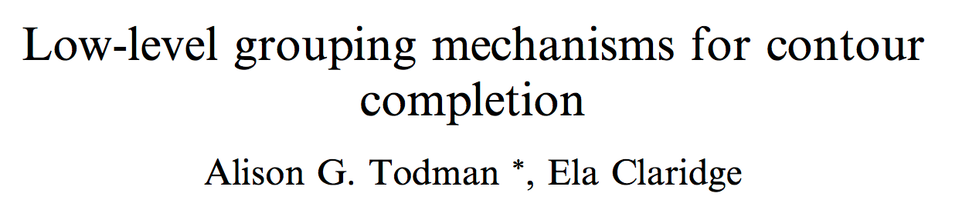
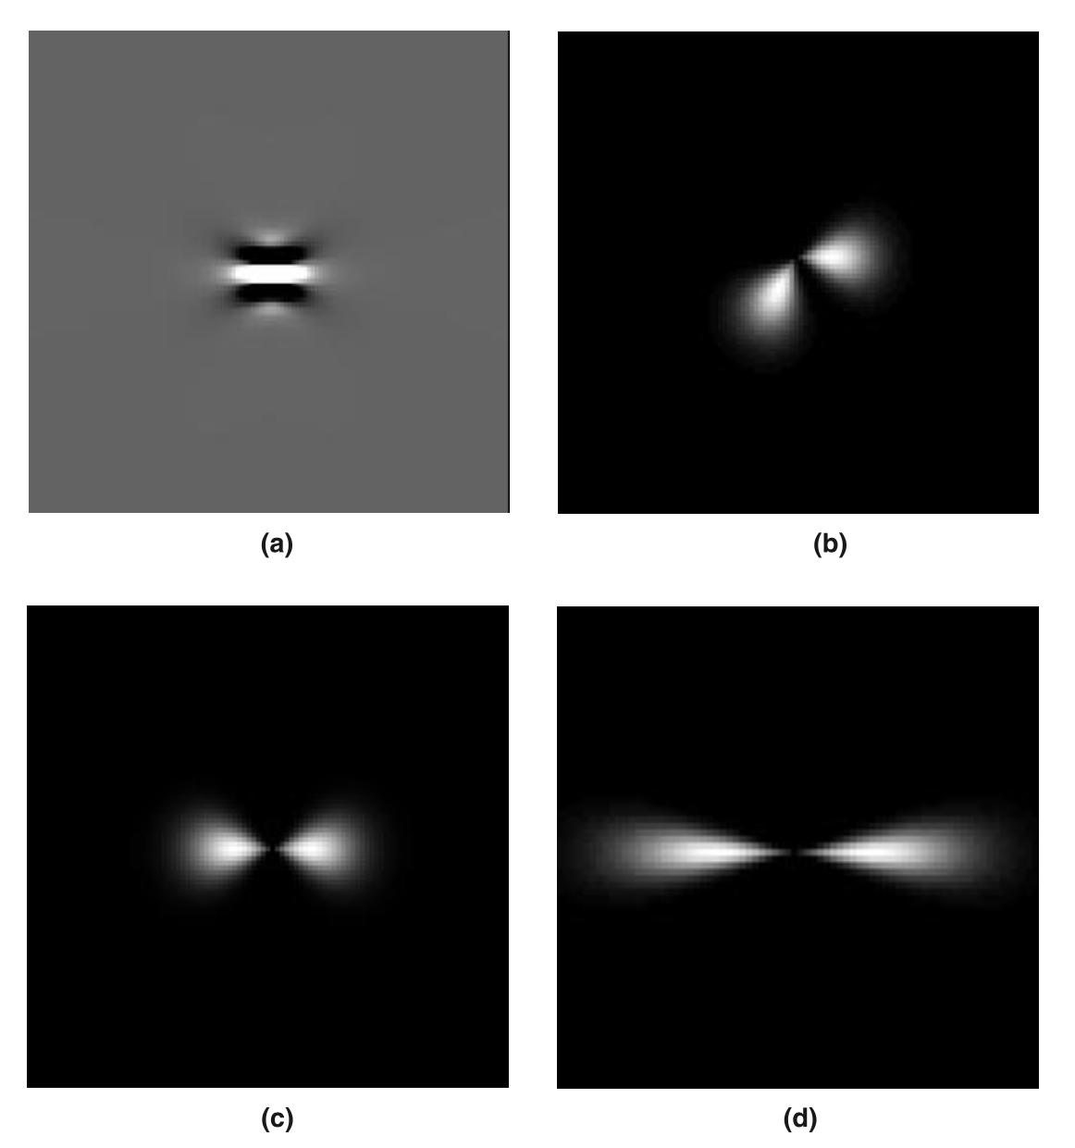
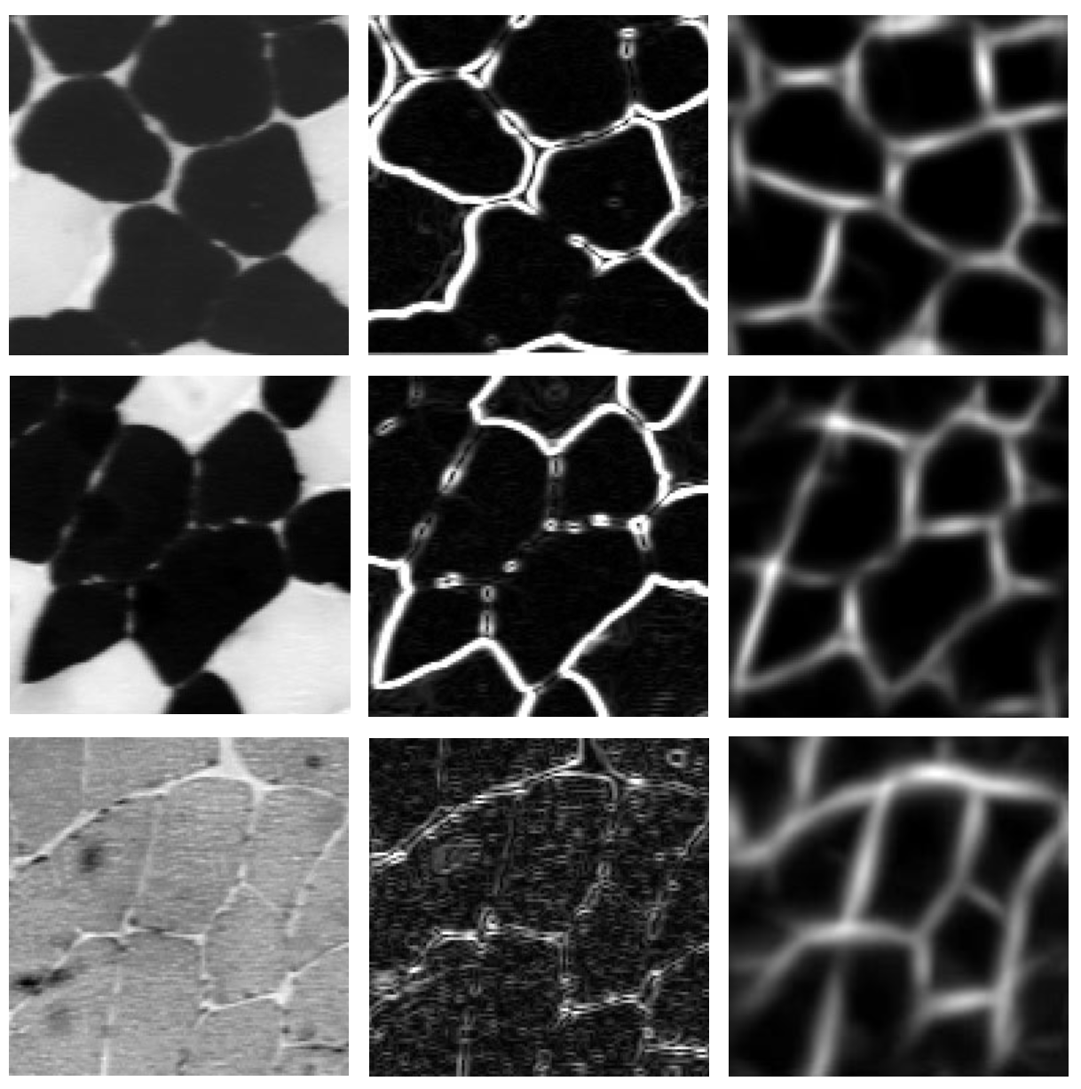
Edge completion method
Examples of filters
Standard edge detection filter
Image

Slide 6
What is segmentation?
Human vision tends to organise the observed scene into meaningful units as a significant step towards image understanding. Further processing is necessary to group edge elements or groups of pixels into structures suited to interpretation.
“The goal of segmentation is to partition an image into disjoined regions which correspond to objects or their parts.”
(T. Pavlidis)

Slide 7



What is segmentation?

Slide 8
Two main approaches
Through extracting boundaries of regions
Based on discontinuities (e.g. in grey levels or statistical properties)
Through extracting regions
Based on similarities
The two approaches are equivalent - one representation can be converted into the other.

Slide 9



Two main approaches
Similarity of pixel values
Dis-similarity of pixel values

Slide 10
Representations for segmented image
Input to segmentation is an image
Output of the segmentation can have several forms:
An image where a pixel value indicates whether the pixel belongs to edge/region or to the background (a binary image).
An image where a pixel value is a region label
e.g. if there are five different regions in the image, there will be five different labels; all pixels belonging to the same region will have the same value in the label image
A data structure which describes the results of segmentation, for example a list of coordinates of the outline of a region.

Slide 11
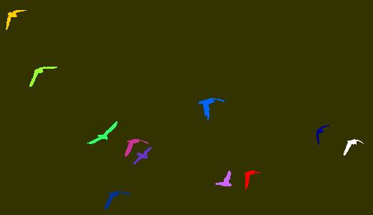
Representations for segmented image
Binary image:
pixel value = 0 for the background
pixel value = 1 for (any) object
Label image:
pixel value = 0 for the background
pixel value = object number
(each colour represents different number)

Slide 12
Region based segmentation Formal definition
The partitioning of an image into set of mutually non-overlapping regions, each of which is maximum connected uniform region.
Connected region - each element of the region is adjacent to at least one other element of this region.
Uniform region - every subset of that region is uniform according to the same criterion
Maximum connected uniform region - no other pixel, adjacent to the region, can be added to it without the region becoming non –uniform.
Uniformity - homogeneity (of the same kind; consisting of parts of the same kind; uniform); e.g. constant grey level

Slide 13
Region based segmentation 4- and 8-connectivity
Current pixel
8-connected pixels:
All the pixels belong to the same region as the current pixel.
4-connected pixels:
Only pixels highlighted blue belong to the same region as the current pixel.
8-connected pixels
4-connected pixels

Slide 14
Region based segmentation 4- and 8-connectivity
8-connected pixels:
Two regions are detected.
4-connected pixels:
Eight regions are detected.

Slide 15
Region based segmentation 4- and 8-connectivity
8-connected pixels:
One region is detected.
4-connected pixels:
Four regions are detected.

Slide 16
Region based segmentation methods
Global - pixels are grouped into regions on the basis of the properties of a large population of pixels (image statistics).
Local - pixels are assigned to regions on the basis of their close neighbours properties.

Slide 17
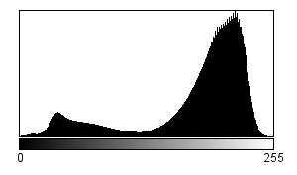
Global methods Pixel classification
Region segmentation can be regarded as process of pixel classification.
The picture is segmented into subsets by assigning the individual pixels to classes.
The choice of the class depends on the global properties (statistics) of the image, e.g. image histogram.

Slide 18
Global methods Pixel classification: thresholding
Thresholding uses a single property and assigns pixels into one of the two classes.
The classes are typically object(s) and a background
The property is typically a grey level value.

Slide 19
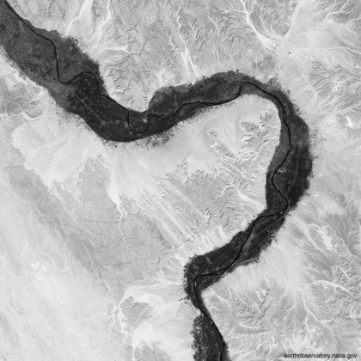
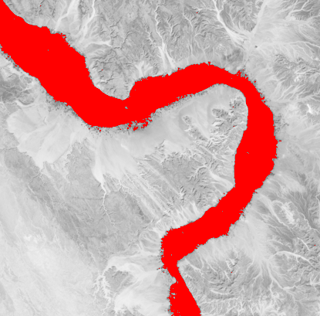
Global methods Pixel classification: thresholding

Slide 20
Global methods Pixel classification: thresholding
The main problem is to find a threshold value which would separate the two classes.
The simplest solution:- build a histogram and find the valley between two peaks (why? – see Exercise 9).
There exist methods for automatic threshold selection (see “Further reading and exploration”).

Slide 21
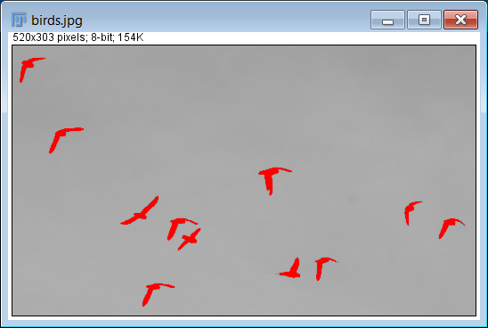
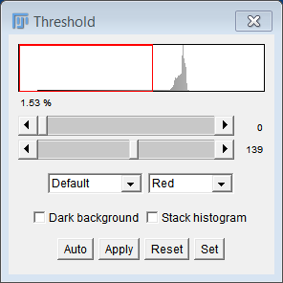
Global methods Pixel classification: thresholding

Slide 22
Global methods Pixel classification: thresholding
Thresholding uses a single property and assigns pixels into one of the two classes.
The classes are typically object(s) and a background
The property is typically a grey level value.
How is image segmentation computed for bright objects on a dark background?
Decide on a threshold value T
Create a new empty image I’
For every pixel in the original image I
if I(x,y) > T
set I’(x,y) to 1
otherwise
set I’(x,y) to 0

Slide 23
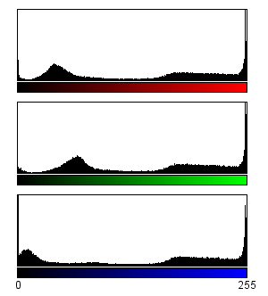
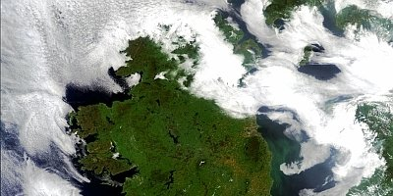
Beyond simple thresholding Single property, several classes
Multi-level thresholding is segmentation into more than two classes.
Colour histograms

Slide 24
Beyond simple thresholding Single property, several classes
Multi-level thresholding is segmentation into more than two classes.
White clouds
Blue water
Green /brown land

Slide 25
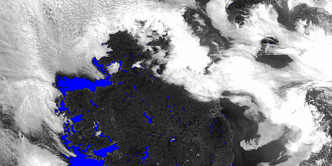
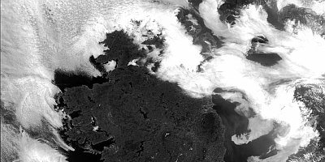
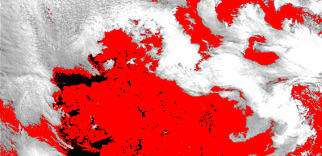
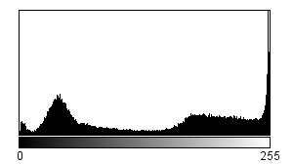
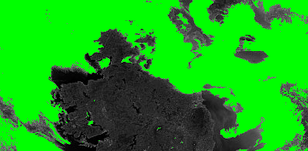
Beyond simple thresholding Single property, several classes

Slide 26
Beyond simple thresholding Several properties, several classes
General statistical classification methods are used.
Supervised classification
Classes are known in advance.
User selects initially some pixels from each possible class.
Classification algorithm determines characteristics of each class.
Each pixel is then assigned to a most likely class.
Stages: training and classification.

Slide 27
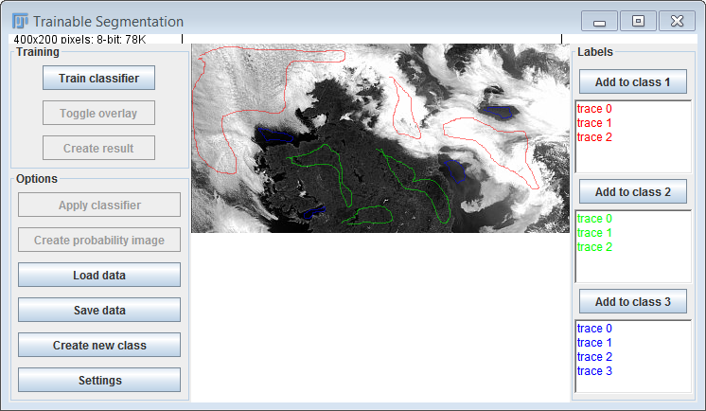
Beyond simple thresholding Several properties, several classes

Slide 28
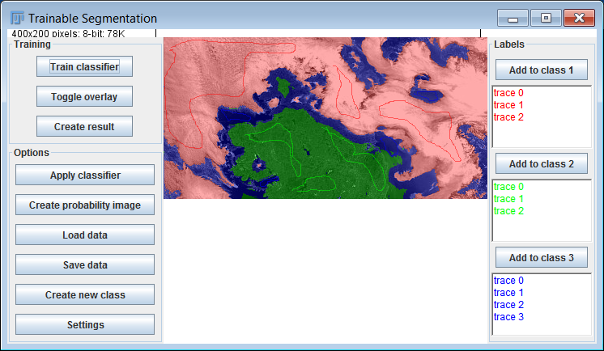
Beyond simple thresholding Several properties, several classes

Slide 29
Beyond simple thresholding Several properties, several classes
General statistical classification methods are used.
Unsupervised classification
Classes are not known in advance.
The classes are determined by the algorithm by locating clusters in a feature space.
Each cluster is assumed to correspond to a class.
Each pixel is then assigned to a most likely class.

Slide 30
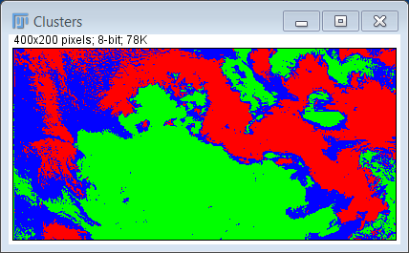
Beyond simple thresholding Several properties, several classes

Slide 31
Beyond simple thresholding Feature spaces for pixel classification
Histogram is a 1-dimensional feature space; a “feature” under consideration is grey level.
Scatter plot - 2 (or more) - dimensional histogram, e.g.
Grey level v/s average grey level in the neighbourhood
Intensity of red v/s intensity of blue
Grey level v/s grey level difference.

Slide 32
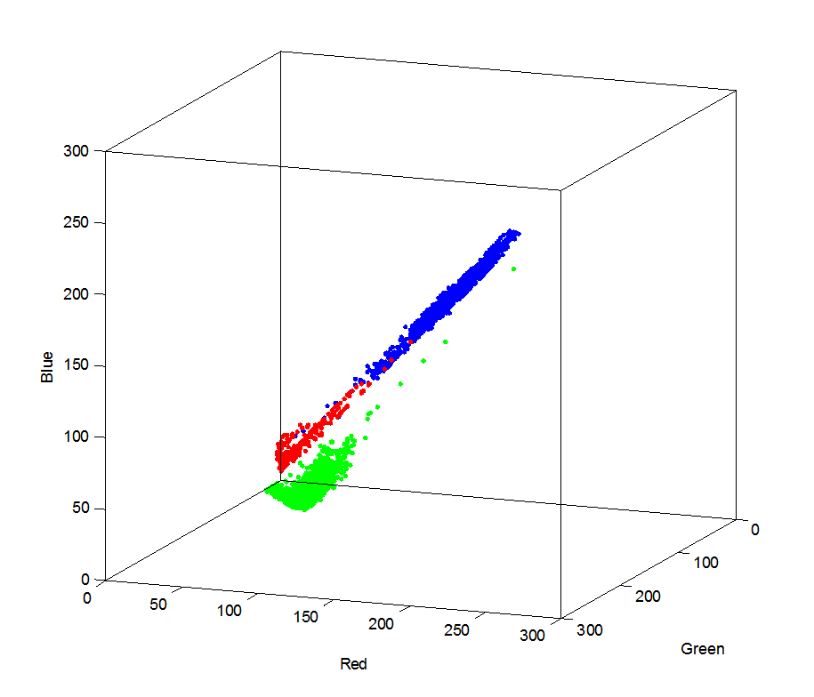
Beyond simple thresholding Feature spaces for pixel classification

Slide 33
Region based segmentation methods
Global - pixels are grouped into regions on the basis of the properties of a large population of pixels (image statistics).
Local - pixels are assigned to regions on the basis of their close neighbours properties.

Slide 34
Local methods Sequential segmentation
Global methods classify all pixels simultaneously, on the basis of the statistics of the whole population of pixels.
Local methods classify pixels or their groups sequentially.
Classification of a given pixel can take into account the result of classification of the pixels already classified.
Sequential segmentation can proceed either “bottom-up” or “top-down”.

Slide 35
Local methods Bottom-up: region growing
Typical steps
Find starting pixels (these are normally pixels in the centre of the identified objects).
Examine all the pixels adjacent to those already selected.
Incorporate those adjacent pixels for which a similarity criterion is met.
Terminate if no more candidates found.

Slide 36
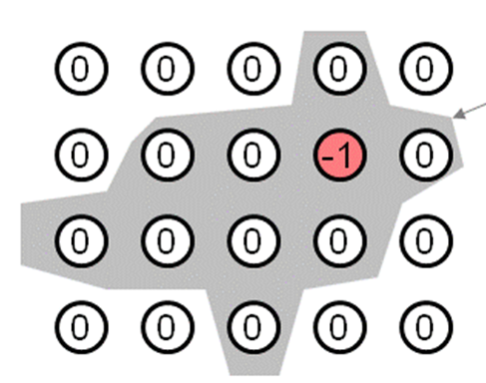
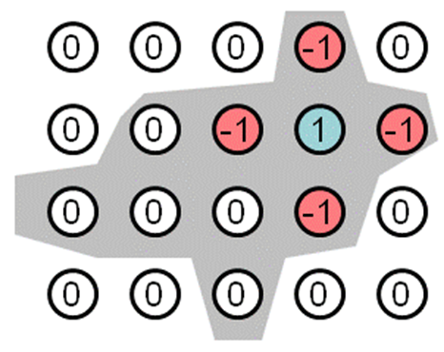
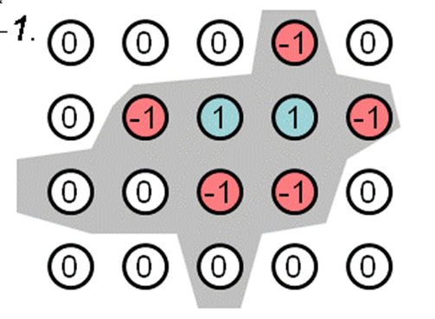
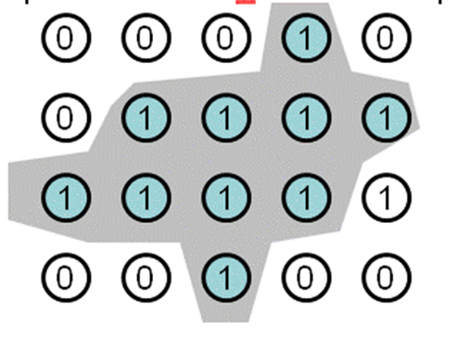
Local methods Bottom-up: region growing
Source: www.csd.uwo.ca

Slide 37
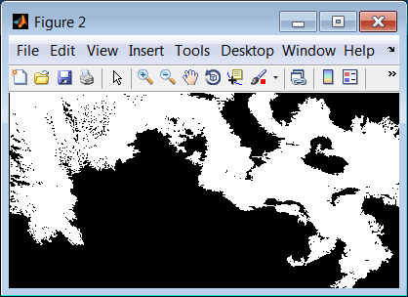
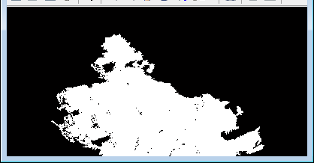
Local methods Bottom-up: region growing

Slide 38
Local methods Top down: image partitioning
Start from an entire image and partition (split) it into uniform regions.
Typical steps
For each partition determine if it meets a similarity criterion.
If it does not, partition it further.
If it does, terminate and move to the next one.
Partitioning uses usually regular sub-divisions, e.g. a region is split into four further sub-regions.

Slide 39
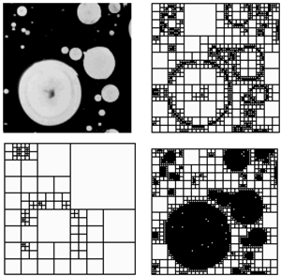

Local methods Top down: image partitioning
http://article.sapub.org/image/10.5923.j.biophysics.20120203.01_001.gif

Slide 40
Segmentation Post-processing
Segmentation often produces objects with irregular boundaries and spurious “holes”, and “noise” in the background.
These can be corrected with various post-processing methods.

Slide 41
In this lecture we have covered:
What is image segmentation
Principles of the region-based segmentation
Global methods: pixel classification
Thresholding
Multi-object classification
Feature spaces
Local methods
Bottom up: region growing
Top down: image partitioning

Slide 42
Next lecture:
Post-processing methods
Mathematical morphology – basic operations
Feature extraction
Mathematical morphology – combined operations

Slide 43
Further reading and experimentation
Book chapters:
Gonzalez, R.C. & Woods, R.E. Digital Image Processing, Addison-Wesley (various editions), 7.3.
Sonka, M. Hlavac, V. Boyle, R. (various editions) Image Processing, Analysis and Machine Vision, Chapman & Hall Computing, 5.
Umbaugh, S.E. Computer vision and image processing : a practical approach using CVIPtools , Prentice Hall International (various editions), 2.4.
Otsu thresholding
https://en.wikipedia.org/wiki/Otsu's_method
HIPR2 resources
Pixel classification
http://homepages.inf.ed.ac.uk/rbf/HIPR2/classify.htm
Pixel labelling
http://homepages.inf.ed.ac.uk/rbf/HIPR2/label.htm

